Slide 1


Ex#9.4
Divergence & Integral Test

Slide 2



Slide 3


Slide 4


Slide 5
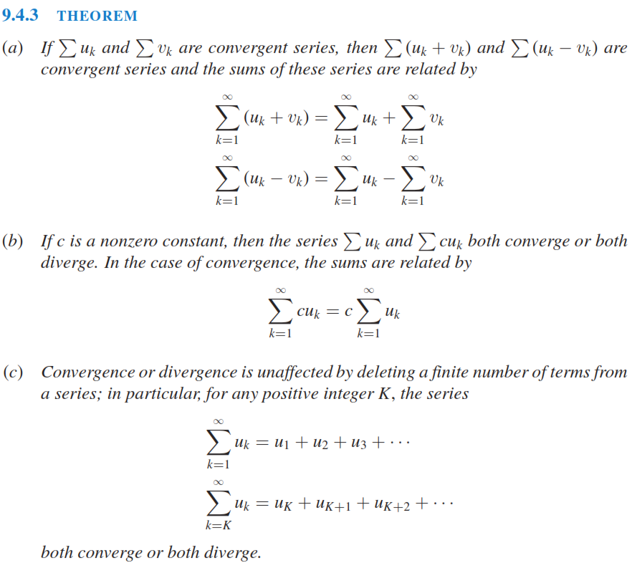

Slide 6
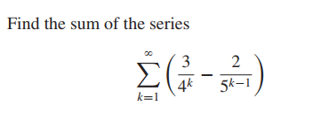
Before finding Sum, check whether its converging or diverging

Slide 7
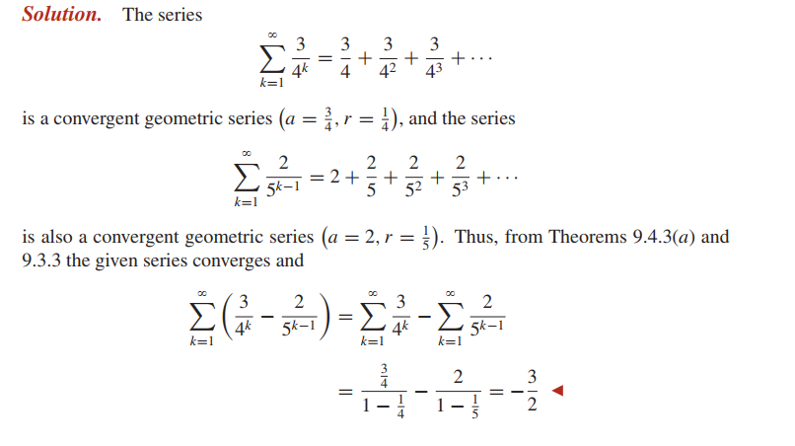

Slide 8


Slide 9


Slide 10


Slide 11



Slide 12


Slide 13


Slide 14


Do by your own

Slide 15



Slide 16
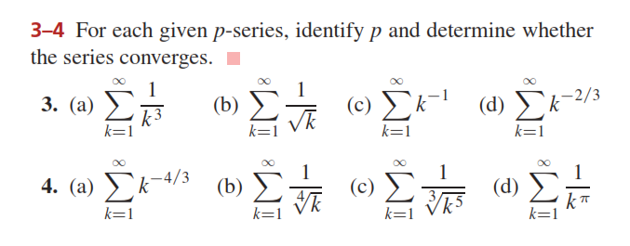

Slide 17
Sol:

Slide 18
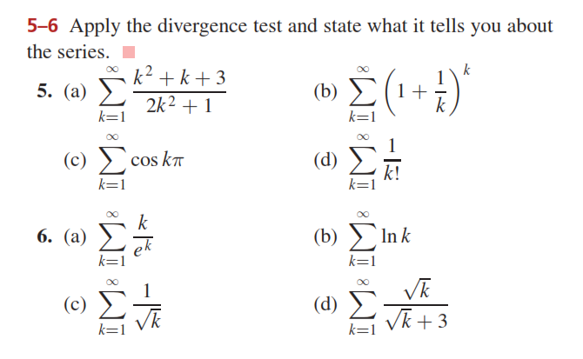


Slide 19
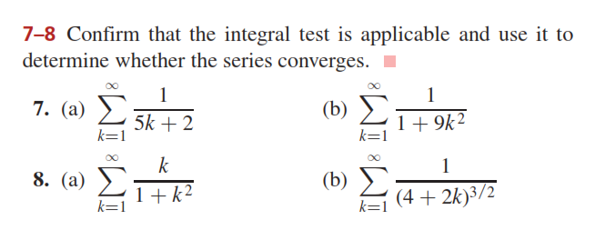



Slide 20
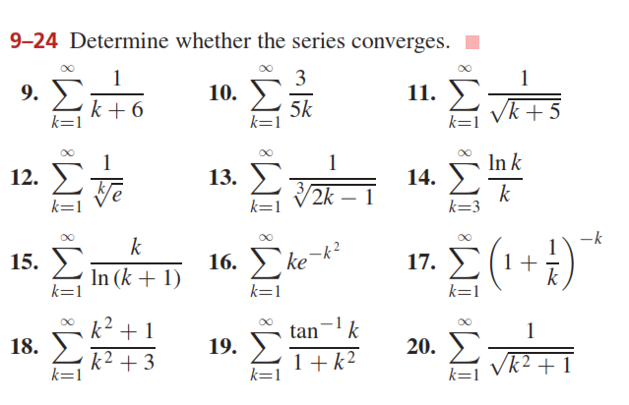
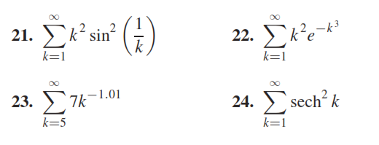

Slide 21
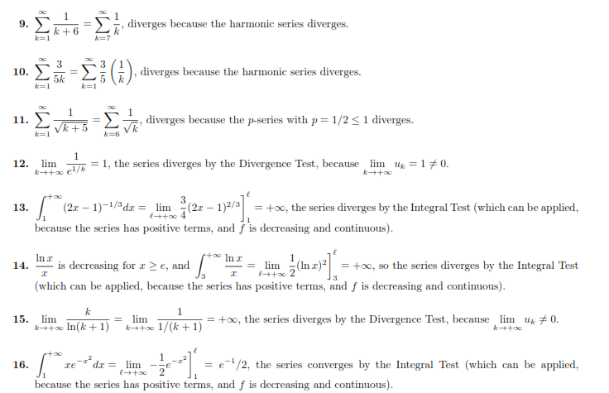

Slide 22
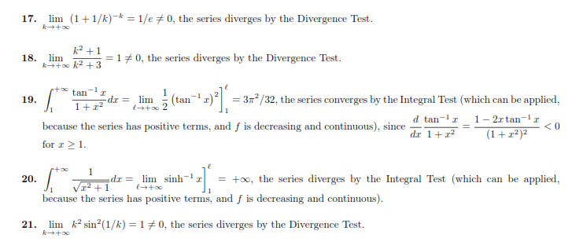


Slide 23
Do Questions (3-24) from Ex # 9.4

